Slide 1
Beyond GLM

Slide 2
Recap

Slide 3
Random effects, mixed models and beyond GLM
Generalised linear models
Random effects and mixed effects models
Polynomial regression
Generalised additive models

Slide 4
Generalised linear models
NB: beware. Some (perhaps many, even most) textbooks use GLM to refer to
Generalised linear models, rather than General linear models.
Here, I’ll abbreviate Generalised Linear Model as GLIM
Generalised linear models are a natural extension of GLMs – all GLMs that we have seen are also GLIMs, and GLIMs also generalise some other methods you may have come across – logistic regression, poisson regression
Essentially, GLIM attempts to relax the GLM assumption of normal errors and homogenous variance, while keeping the general framework of linear combinations of effects

Slide 5
Generalised linear models
A GLIM consists of three elements:
1. A distribution function f, from the exponential family, which specifies the shape of the error variance.
2. A linear predictor η, which is a linear combination of categorical and continuous explanatory variables, in exactly the same way as a model formula in a GLM
3. A link function g such that for fitted value y, g(y) = η. This controls how the combined explanatory variables are related to the fitted values for the response.

Slide 6
Generalised linear models
Note that for a link function g:
g(y) = η is the same as: y = g⁻¹(η)‏
The equation for a GLIM looks like this:
e.g. For 2 categorical factors
y_{i,j,k} = g⁻¹(α_{i} + β_{j})+ε_{i,j,k}
Note that g is almost the same as transforming the response variable, except that it does not affect the error term: this means you can alter distribution of the residuals separately from the variance

Slide 7
GLM as Generalised linear model
To help you get your bearings, a GLM is a GLIM with
the normal distribution as its error distribution function
and the ‘identity link’ – i.e. The fitted values are exactly equal to the values of the linear predictor

Slide 8
Assumptions
GLM
GLIM
Independence
Normality of error
Homogeneity of variance
Linearity/additivity
Independence
Error follows distribution function
Variance distribution depends on distribution function
Linearity/additivity

Slide 9
Going from GLM to GLIM..
Lots of things stay familiar:
Model formulae
Partition variation in the data into different effects
Fit mixtures of categorical and continuous explanatory variables
Main effects and interactions
Coefficients, fitted values, residuals
Still need to check assumptions
Some things change:
Error not normal, variance not constant
In general, no more F, no more SS or MS. Instead we have deviance (-2 * log likelihood) and a test using (usually) a χ² distribution

Slide 10

Binomial (binary) data and logistic regression
So far, all of our response variables have been measured on a continuous scale. GLIMs can be used to fit other kinds of responses, for example binomial data (taking only the values 0 or 1).
For this kind of data, we attempt to model the proportion of 1s and 0s i.e. a continuous variable between 0 and 1.
The appropriate tool for regression with this kind of data is called logistic regression. It is a GLIM with:
distribution function: binomial
link function: logit

Slide 11
Count data
Data based on counts is notoriously hard to analyse by ANOVA, GLM etc. Typically:
Variance increases with the mean
Zero counts are present – make transformations difficult
Errors are not normally distributed
Linear models will predict negative or fractional counts – these are nonsensical

Slide 12
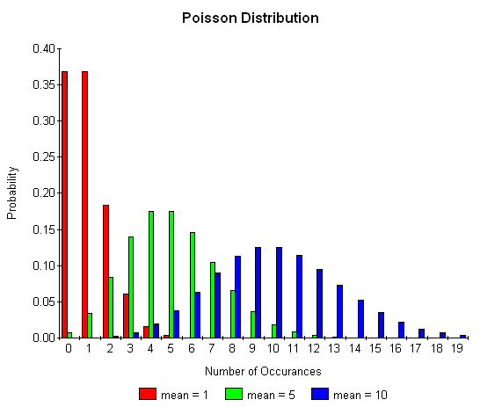
Poisson errors

Slide 13
Poisson errors in a GLIM
This uses
the poisson distribution as its distribution function
and a log link: the fitted values are e^{(linear predictor)}

Slide 14
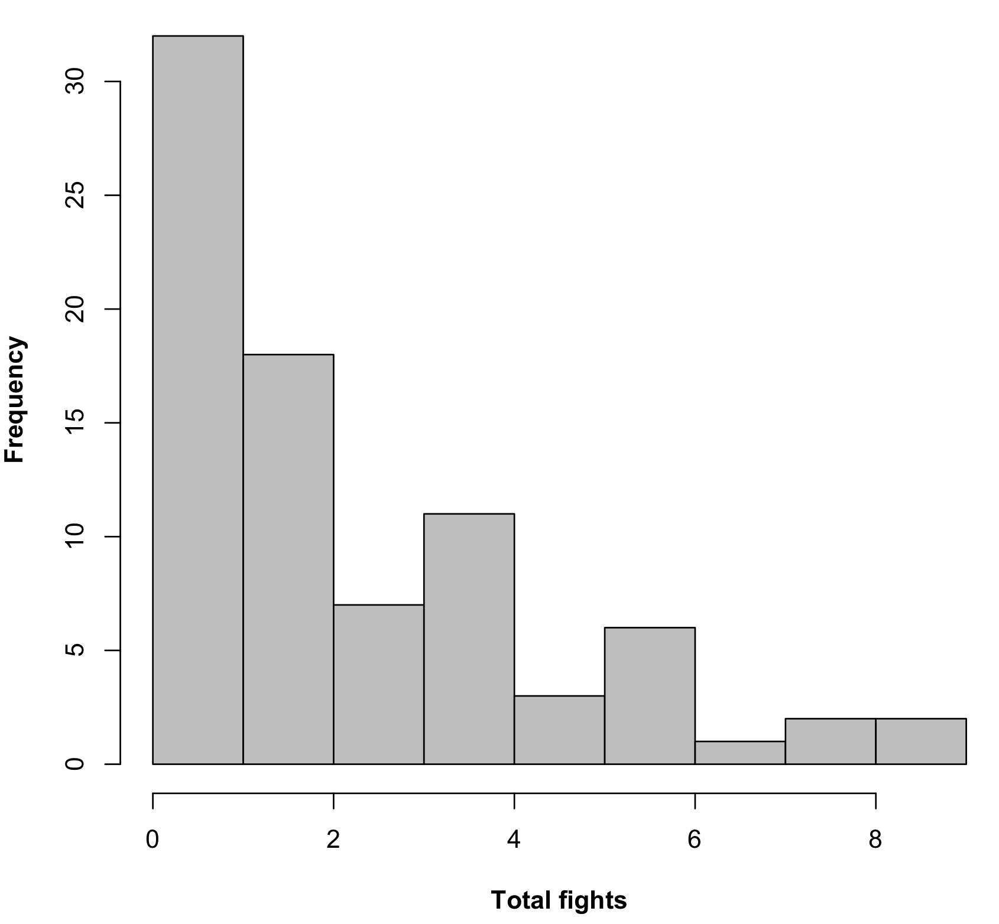
Poisson regression example
These data consists of counts of fights for a single male Teleopsis dalmanni at various densities

Slide 15
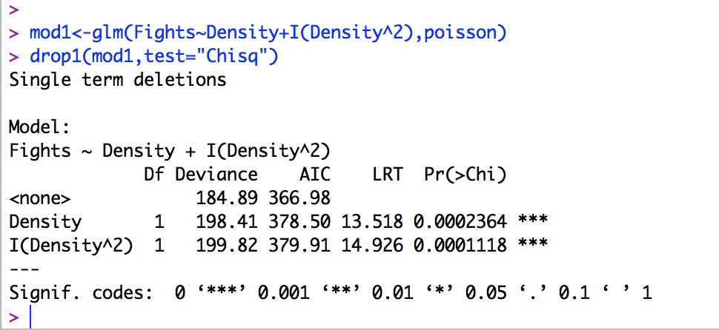
Poisson regression example

Slide 16
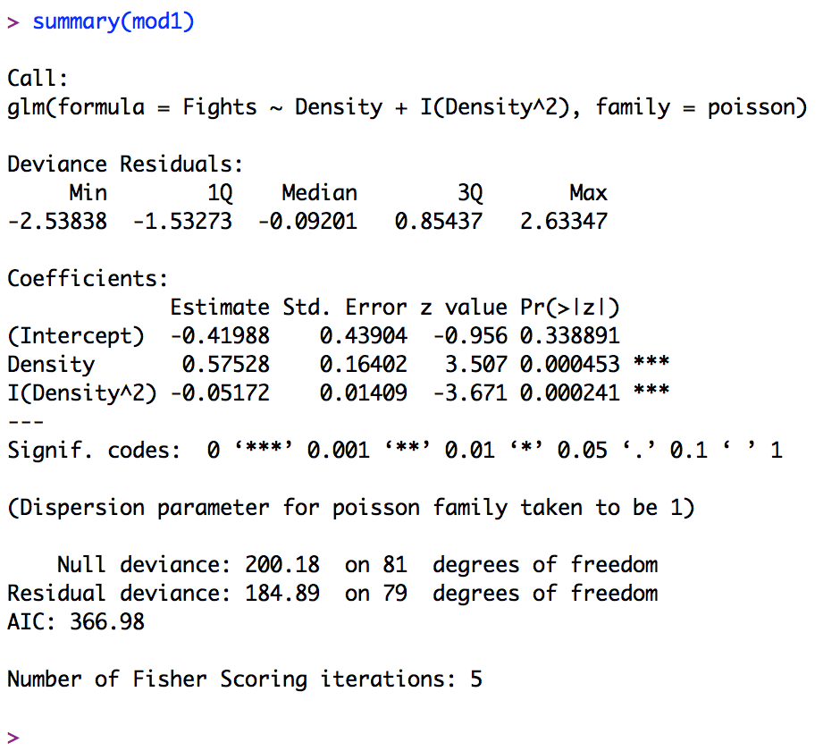
Poisson regression example

Slide 17

Poisson regression example

Slide 18
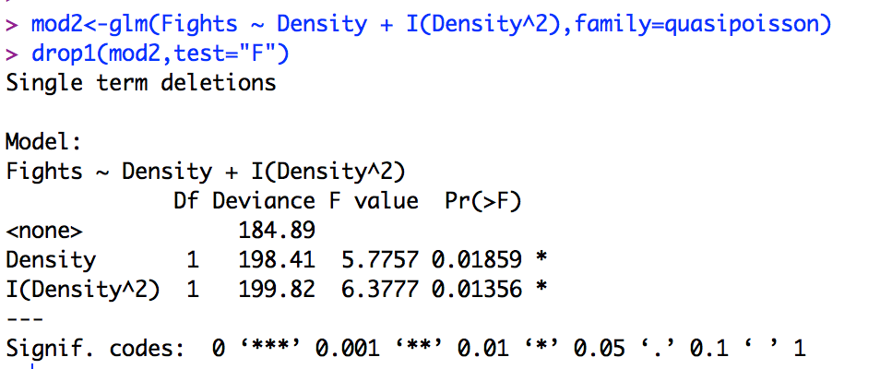
Poisson regression example

Slide 19
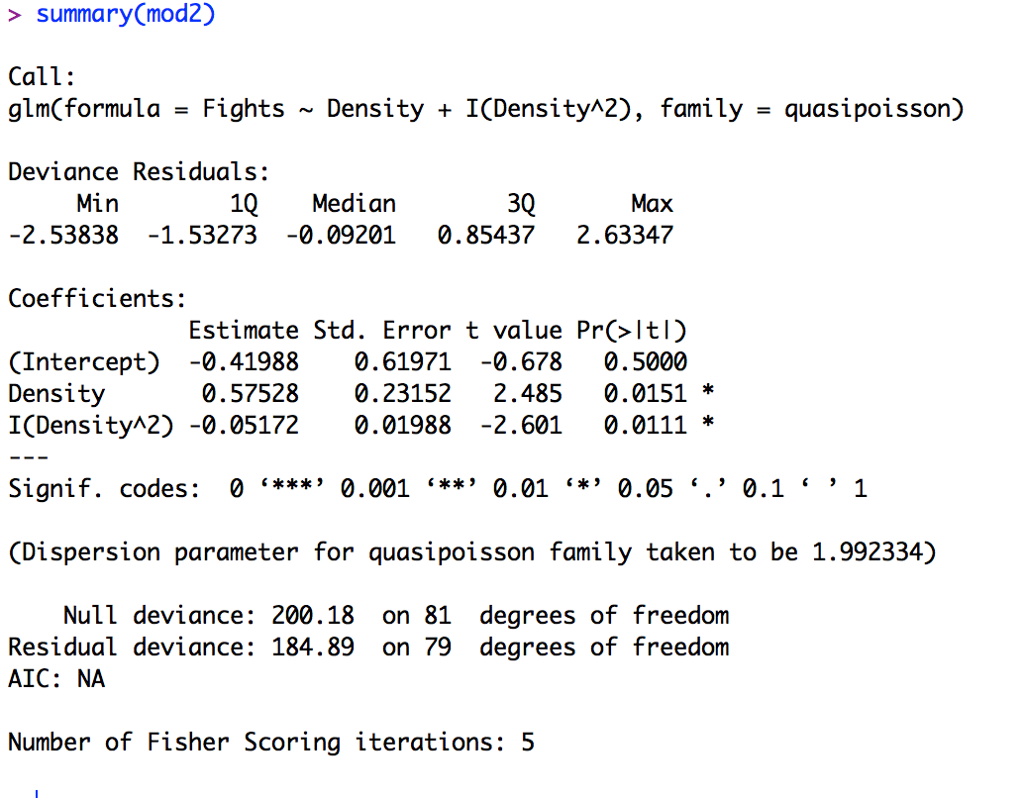
Poisson regression example

Slide 20
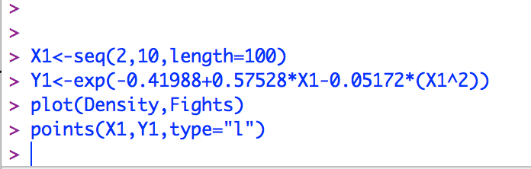
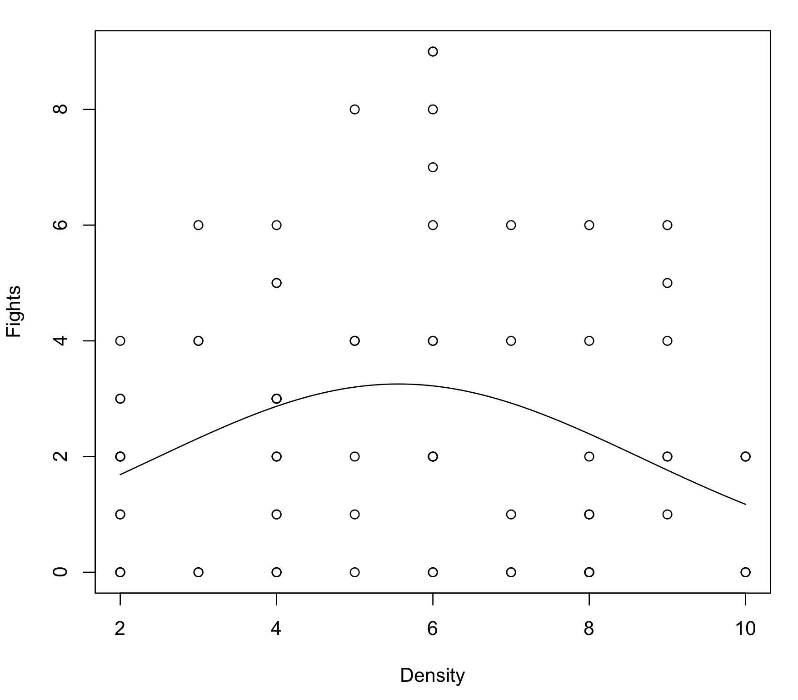
Poisson regression example

Slide 21
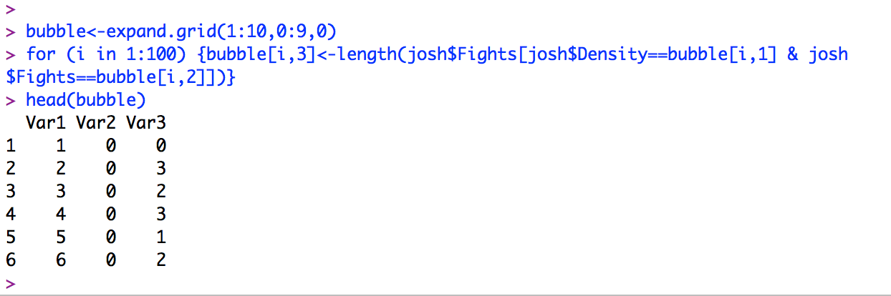
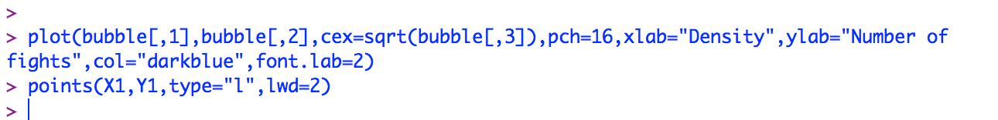
Poisson regression example

Slide 22
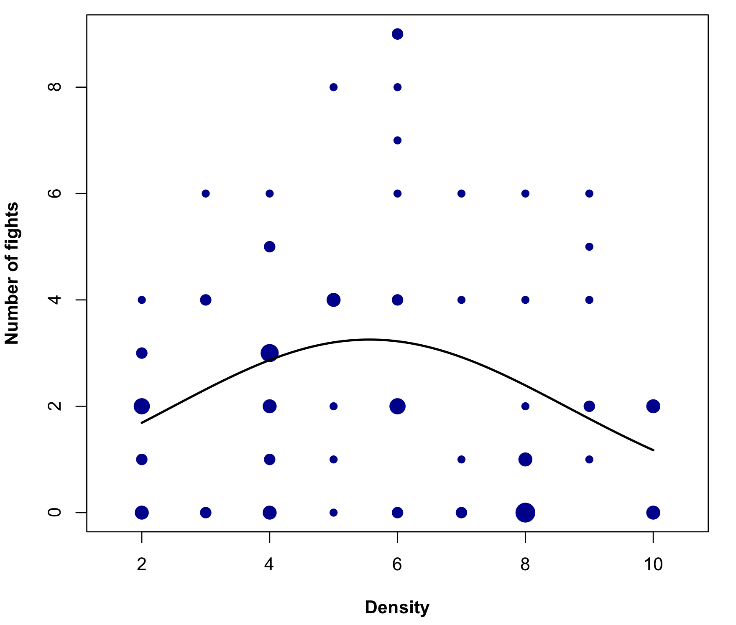
Poisson regression example

Slide 23
Random effects and mixed effects models

Slide 24
What are random effects?
So far, all the factors we have examined have been
fixed effects. For a fixed effect, we assume that we have included all levels of interest in the experiment, and our conclusions will be restricted to those levels
A random effect is a categorical variable where the levels can be thought of as random samples from a population of levels that we wish to reach conclusions about

Slide 25
What are random effects?
Another way to identify random effects is to think about repeating the experiment:
Would we consider the experiment meaningfully repeated only if we used the same levels of the factor, or would different levels be acceptable?

Slide 26
What are random effects?
Criterion:
Fixed effects
Random effects
Repetition: If the experiment were repeated:
Same levels would be used
Different levels would be used
Desired inference: The conclusions refer to:
Just the actual levels used
A population from which the levels used are just a (random) sample

Slide 27
Common random effects
Brood
Block within a field
Household
Individuals in repeated measures designs
Parent

Slide 28
Random effect models
ANOVA: for a response weight_gain and explanatory factor diet, with a random effect being the individual animal chosen for the experiment from some population
Weight gain_{i,j} = diet_{i} + individual_{i +} ε_{i,j}
In a random effects model, both individual and the error term are random variables, drawn independently for each observation from a normal distribution with mean 0.
So both the random effect term and the error have variance
The variation in weight gain due to error and individual can be divided up into two components of variance

Slide 29
Different hypotheses
For fixed effects, we’re interested in the effect different levels have on the mean response, so e.g. For a four-level factor, a null hypothesis would be
μ₁ = μ₂ = μ₃ = μ₄
For a random effect, this question is of no interest – we don’t care about the mean effect of choosing a particular leaf to measure. What we’re interested in is the variance between different leaves. The null hypothesis is:
σ_{i}² = 0

Slide 30
Nesting
Random effects models are often nested, rather than crossed/factorial.
so each level (e.g. Biological Individual) of the random factor is only exposed to a single combination of factors
Treatment 1
Treatment 2
individual
1 2 3 4
5 6 7 8

Slide 31
Denominators for F ratios
So far, the error MS has been the denominator for all the F ratios we have calculated.
This is also true for the lowest level of factors in a nested design, but not for others..
For some designs, no denominator exists.. ‘synthetic denominators’ are calculated in a way I don’t really understand!

Slide 32
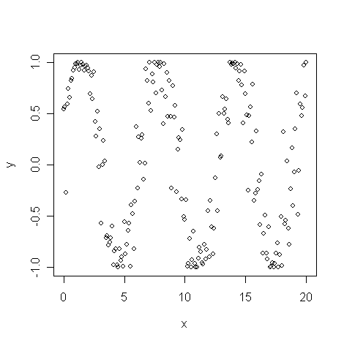
Highly non-linear data
Sometimes we get data that is inherently non-linear, and difficult to fit with polynomials:

Slide 33
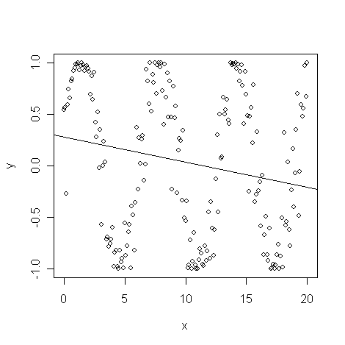
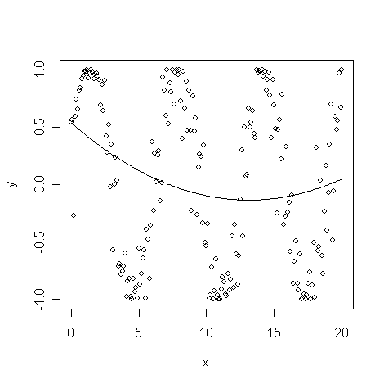
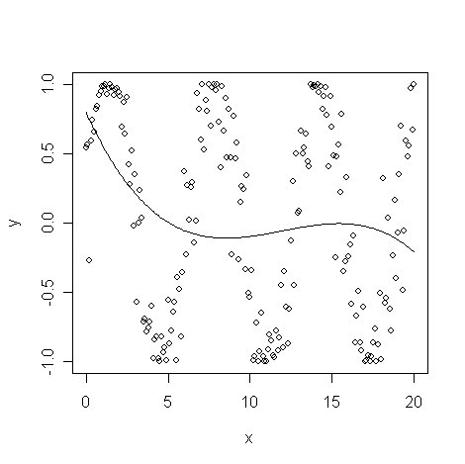
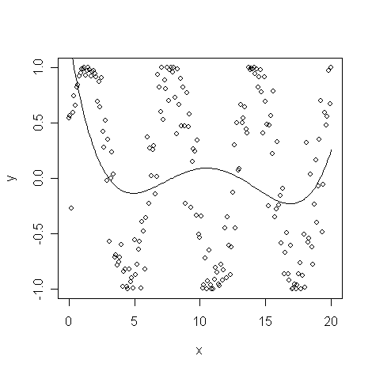
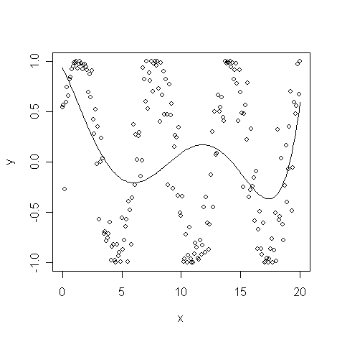
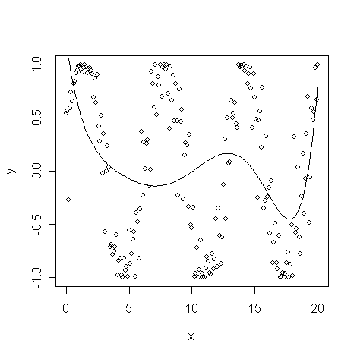
Polynomial regression
Fitting higher order polynomials in turn:

Slide 34
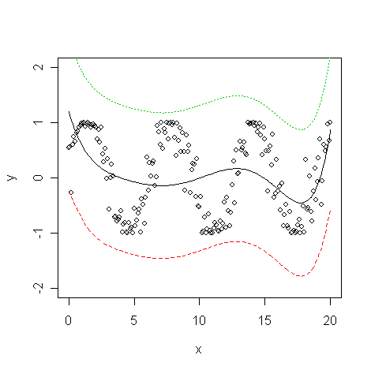
Polynomial regression is doing a terrible job!

Slide 35
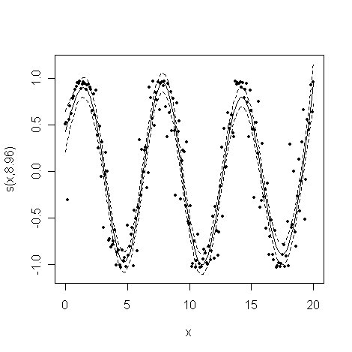
General additive models

Slide 36
What is a General additive model?
GLM single-factor regression equation: height_{i} = α + β.y + ε_{i}
GAM single-factor regression equation: height_{i} = α + S(y) + ε_{i}
Where S(y) is a non-parametric smoother fitted to y
NB: Generalised additive models also exist

Slide 37
Non Parametric Smoothing
e.g. Running means, Lowess regression, cubic splines
Perform averaging/linear regression/polynomial regression
On a window sliding along the data:

Slide 38
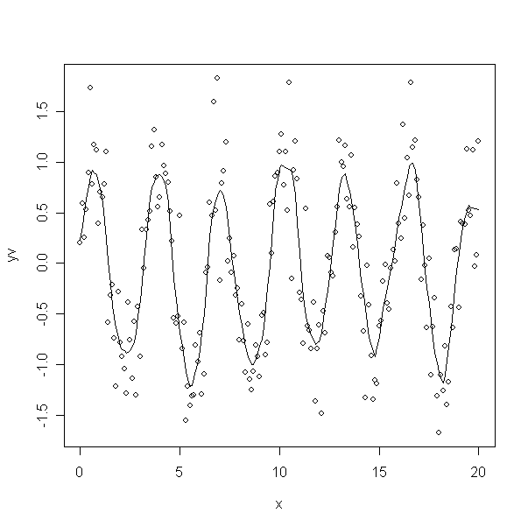
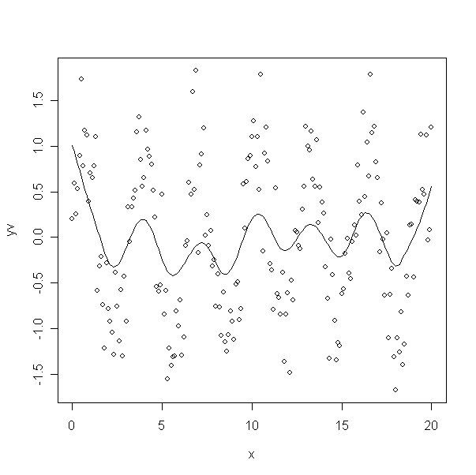
Non Parametric Smoothing
Effect of Window size

Slide 39
General additive model
Just like with GLM, you can also do hypothesis testing with GAMs
The basic idea is familiar: measure SS of points away from the mean (total SS), the SS of points away from the smoothing line (error SS) and the SS of the line from the mean (effect SS)‏
Calculate an F-ratio as normal.
The difficulty is in calculating how many degrees of freedom the smoothed line has. This has to be estimated - usually, this isn’t an integer, and is approximate

Slide 40
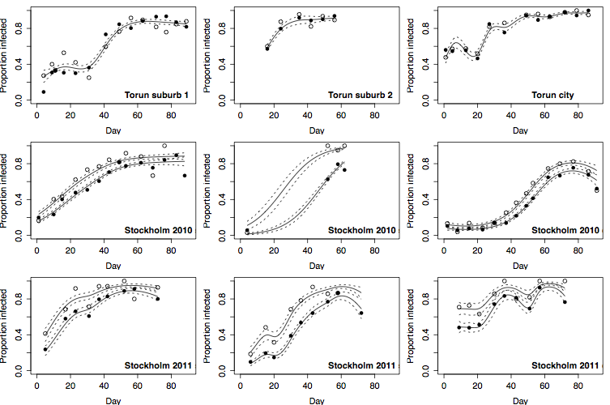
General additive models
Ryder, J.J., Hoare, M.-J., Pastok, D., Bottery, M., Boots, M., Fenton, A., Atkinson, D., Knell, Robert J., and Hurst, G.D.D. (2014). Disease Epidemiology in Arthropods Is Altered by the Presence of Nonprotective Symbionts. The American Naturalist 183, E89–E104.

